Slide 1
Relational Databases

Slide 2
Contents
Database Models
RDBMS
Tables and Relationships
Entity-Relationship Diagrams
Normalization
Constraints
Indices
Overviews
SQL
Stored Procedures
Views
Triggers
Transactions

Slide 3
Database Models
Hierarchical (tree)
Network (graph)
Relational (table)
Object-oriented
Document-based (NoSQL, JSON, etc)

Slide 4
Relational Databases
Tables grouped together with relationships between them
Rely on a strong mathematical foundation: relational algebra
Based on first-order predicate logic
Data represented in terms of tuples (finite ordered list of elements, or records), grouped into relations.
Eight (8) basic operations, with origins in mathematical set theory:
Select
Union
Intersection
Difference
Cartesian Product (cross product)
Projection
Join
Relational Division

Slide 5
Relational Database Management System (RDBMS)
Manage the data stored in tables
Implement support for SQL
Standard data operations
Creating / altering / deleting tables and relationships between them (database schema)
Add, change, delete records stored in database tables
Search and retrieve data stored in database tables
Search by individual criteria
Search by relationship
Also known as:
Database management servers
Or just database servers

Slide 6
Top 5 RDBMS Servers
Notes:
Oracle
Still on top since 1979
Ultra-powerful but complex solutions
Pricey
Microsoft SQL Server
Ease of use
Availability
Tight Windows integration
MySQL
Began as niche product, acquired by Sun in 2008, Oracle in 2009
Now powers commercial websites by the hundreds of thousands
Popularity among users and devs has eroded since acquisition by Oracle
Erosion created market for new open-source projects (MariaDB, Percona, Drizzle)
PostgreSQL
Open source
Object-relational database management system (ORDBMS)
Hides in interesting places like online gaming applications, data center automation suites and domain registries.
Used at Skype and Yahoo
Multi-platform (Linux, Windows, FreeBSD, Solaris, OS X)
Includes enterprise-grade features comparable to Oracle and DB2
IBM DB2
Big data
Multi-platform: Linux, Unix, Windows, IBM iSeries, mainframes
Cheaper competitor with Oracle (34 – 39% cost savings to switch)

Slide 7
RDBMS Servers - continued
LOTS of choices (literally dozens of others)
And that’s just RDBMS
Also Document-based and Object-based… On the rise
Why so many? What makes a system a good match?
We teach SQL Server here. Why not one of the others?
It’s all about .NET

Slide 8
What Makes a DBMS Relational
Let’s talk about Tables
Database tables consist of data, arranged in rows and columns
For example (table Persons):
All rows have the same structure
Columns have a name and data type (number, Boolean, string, date, image, other)
Id | First Name | Last Name | Employer
1 | Heinz | Doofenshmirtz | D.E.I.
2 | Perry | Platypus | AnimalAgents
3 | Phineas | Flynn | NA

Slide 9
Primary Keys
A primary key is a column that uniquely identifies its row(s) within a table
Two rows (records) are different if and only if their primary keys are different
The primary key can be composed by several columns if necessary (composite primary key)
Primary key
Id | First Name | Last Name | Employer
1 | Heinz | Doofenshmirtz | D.E.I.
2 | Perry | Platypus | AnimalAgents
3 | Phineas | Flynn | NA

Slide 10
Relationships
Relationships between tables are based on interconnections between primary keys and foreign keys
Primary key
Foreign key
Primary key
Cities
Id | Name | CountryId
1 | Frankfurt | 1
2 | Berlin | 1
3 | London | 2
4 | Liverpool | 2
5 | New York | 3
Countries
Id | Name
1 | Germany
2 | United Kingdom
3 | United States

Slide 11
Relationships (continued)
A foreign key identifies a record located in another table (usually by its primary key)
Using relationships avoids redundant data in the database
i.e. The name of the country only appears once in the Countries table, but is referenced multiple times by foreign key
Types of Relationships (multiplicity):
One-to-many – (country / towns)
Many-to-many – (student / course)
One-to-one – (human / student)
Self

Slide 12
One-to-Many Relationships
A single record in the first table has multiple corresponding records in the second table
This is the most common relationship in RDB systems
Cities
Id | Name | CountryId
1 | Frankfurt | 1
2 | Berlin | 1
3 | London | 2
4 | Liverpool | 2
5 | New York | 3
Countries
Id | Name
1 | Germany
2 | United Kingdom
3 | United States

Slide 13
Many-to-Many Relationships
Records in one table have multiple corresponding records in another table
Implemented through a join table
UserRoles
Users
UserId | RoleId
1 | 2
1 | 4
2 | 3
3 | 1
3 | 4
4 | 4
5 | 5
6 | 1
Roles
Id | UserName
1 | Doof
2 | AgentP
3 | Phineas
4 | Ferb
5 | Carl
6 | Monogram
Id | Name
1 | Administrator
2 | Evil Genius
3 | Nemesis
4 | Inventor
5 | Intern

Slide 14
One-to-One Relationships
A single record in one table corresponds to a single record in another table
This relationship is used to model inheritance (OOP) between tables
Primary keys match across tables
People
Specialists
Id | Name
1 | Heinz
2 | Perry
3 | Phineas
4 | Ferb
5 | Carl
6 | Monogram
Id | Specialty
1 | Evil
2 | Thwarting
Brass
Id | Title
6 | General

Slide 15
Self Relationships
Used to represent trees and graphs
Primary/foreign key relationships point to the same table
Example: File system
Primary key
Foreign key
Self-relationship
Id | FolderName | ParentFolderId
1 | Root | null
2 | Documents | 1
3 | Media | 1
4 | Downloads | 1
5 | Pictures | 3
6 | Videos | 3
7 | Music | 3

Slide 16
Relationship Schemas
A relational schema is a collection of:
The schemas (definitions) of all tables in the database
The relationships between all tables in the database
All other database objects, such as constraints
A relational schema describes the database structure ONLY
No data, just metadata
Display relational schemas using Entity/Relationship(E/R) diagrams

Slide 17
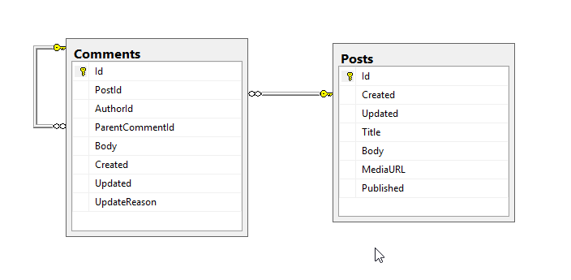
E/R Diagrams
Created with MS SQL Server Management Studio

Slide 18
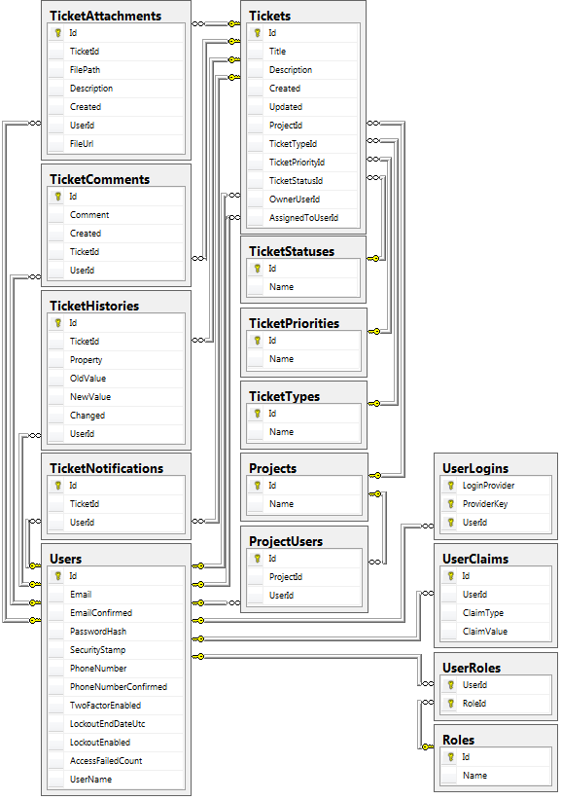
E/R Diagrams (continued)

Slide 19
Tools for E/R Design
There are MANY data modeling tools you can use to build E/R diagrams, and to generate database schemas
Just a few of the more popular ones…
SQL Server Management Studio
Oracle JDeveloper
Microsoft Visio
CASE Studio
IBM Rational Rose

Slide 20
What is Normalization?
Normalization is the removal of duplicate data from the database
Normal Forms
1st Normal Form
Data is stored in tables
There are no repetitions within a single row
A primary key is defined for each table
2nd Normal Form (1st Normal Form PLUS…)
No columns that depend on part of a composite primary key
3rd Normal Form (2nd Normal Form PLUS…)
No dependencies between columns except "a column depends on the PK"
4th Normal Form (3rd Normal Form PLUS…)
Only one column in each table that can have many possible values for a single key

Slide 21
Non-Normalized Schema
Product | Producer | Price | Category | Shop | Town
Jello-Inator | Doof, Inc. | 16500 | Inators | InatorsRUs | Danville
Time-Traveling Coaster | Agents, Ltd. | 120000 | Contraptions | ACME | Nowhere
Cardboard Cruise Ship | Agents, Ltd. | 1450 | Contraptions | ACME | Danville
HiccupInator | Doof, Inc. | 27400 | Inators | InatorsRUs | Danville

Slide 22
Normalized Schema
Id | Product | ProducerId | Price | CategoryId | ShopId | TownId
1 | Jello-Inator | 1 | 16500 | 2 | 2 | 1
2 | Time-Traveling Coaster | 2 | 120000 | 1 | 1 | 2
3 | Cardboard Cruise Ship | 2 | 1450 | 1 | 1 | 1
4 | HiccupInator | 1 | 27400 | 2 | 2 | 1
Producers
Categories
Shops
Towns
Id | Name
1 | Doof, Inc.
2 | Agents, Ltd.
Id | Name
1 | Contraptions
2 | Inators
Id | Name
1 | ACME
2 | InatorsRUs
Id | Name
1 | Danville
2 | Nowhere

Slide 23
Constraints
Integrity constraints enforce specific data rules that cannot be violated to ensure data integrity throughout the database tables
Primary key constraint ensures that the primary key has a unique value for each row in the table
Unique key constraint ensures that all values in a particular column (or a group of columns) are unique, that is, they occur only once in the table
Foreign key constraint ensures that the value referenced in a particular column is a primary key from another table
Check constraint ensures that values in a particular column meet a particular predefined condition
Hour values are between 0 and 24…
Values are upper case…

Slide 24
Indices
Indices speed up searching of values in a particular column or group of columns
Indices can be built-in the table (clustered) or stored externally
Adding and deleting records in indexed tables is slower, but searching indexed tables is significantly faster
Use indices for large tables (> 50,000 rows), to realize search performance benefit

Slide 25
What is SQL?
SQL (Structured Query Language)
Standardized declarative language for manipulating relational databases
Supports:
Creating, altering, deleting tables and other objects in the database
Searching, retrieving, inserting, modifying and deleting table data (rows)
Consists of:
DDL – Data Definition Language
CREATE, ALTER, DROP commands
DML – Data Manipulation Language
SELECT, INSERT, UPDATE, DELETE commands
MUCH more to come on SQL later

Slide 26
What are Stored Procedures?
Stored Procedures are database-level procedures
Consist of SQL-like code stored in the database
Code executed inside the database server
Much faster than an external code
Data is locally accessible
Can accept parameters
Can return results
Single value
Record sets
Stored procedures are written in a language extension of SQL
T-SQL – in Microsoft SQL Server
PL/SQL – in Oracle
MUCH more to come on Stored Procs later…

Slide 27
What are Database Views?
Views are named SQL SELECT queries used as tables
Similar to a Stored Proc
Simplify data access
Facilitate writing of complex SQL queries
Used also to apply security restrictions:
E.g. a certain user isn't given permissions on any of the tables in the database
The user is given permissions on few views (subset of DB) and few stored procedures only

Slide 28
Let’s design and build something!
Pick something you’d like to model
Books
Movies
Video Games
Exercise Programs
Recipes
Etc…
Design a database on paper to reflect that model, keeping in mind the need for normalization (reducing redundancy)

